Slide 1
Malware & Software Security

Slide 2
Today’s Plan
09:00 – 10:00: MALWARE SECURITY (William Stallings, Lawrie Brown, Computer Security Principles and Practice [Chapter 6], Third edition, Pearson, Australia) & SOFTWARE SECURITY (Various Sources).
10:00 – 10:30: Demo: Lab 7 Completion.
10:30 – 12:00: Coursework.

Slide 3
Malware Security

Slide 4
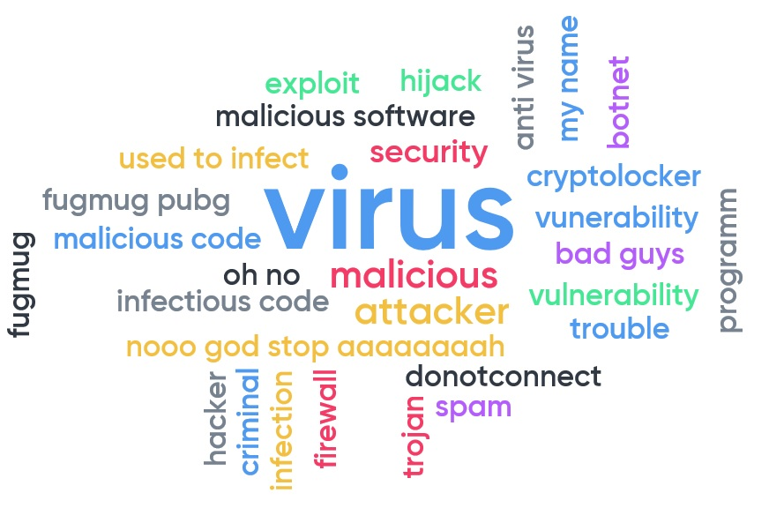
What are we fighting against?
Propagation Mechanism:
Infection of existing files (viruses).
Exploitation of network vulnerabilities (worms).
Social engineering attacks (trojans).
Blended attacks (multiple methods of propagation).
Advanced Persistent Threats (careful target selection).
Types of Payload:
Data destruction.
Data kidnapping.
Real-world damage.
Logic bombs.
Bots/Zombies.
Information theft (phishing).
Stealthing (rootkit/backdoor).
Cryptojacking.
ANTI

Slide 5
Prevention
Hardening the system.
Four main elements of prevention:
Policy
Awareness
Vulnerability mitigation
Threat mitigation
Update systems.
Set appropriate access controls (reduce accessible files by any user).
User awareness training (against social engineering attacks).

Slide 6
Effective Malware Countermeasures
Generality: Wide variety of attacks.
Timeliness: Quick response.
Resiliency: Resistant to evasion techniques.
Minimal denial-of-service costs: Should not disrupt normal operations.
Transparency: Should not alter legacy OS, SW and HW.
Global and local coverage: Deal inside and outside network.
The more are used, more in line with the defence-in-depth principle.

Slide 7
Technical Mechanisms
Once attack occurs, support by:
Detection: Determine that attack has occurred and locate malware.
Identification: Specific malware.
Removal: Eliminate all traces.
Detection but no Identification/Removal: Backup version.
Three places to detect:
In host (host-based scanner).
In network (firewall).
In general (distributed mechanism).

Slide 8
Host-Based Scanner
Four generations:
Simple scanner: Requires a malware signature or a length change identification.
Heuristic scanner: Searches for probable malware instances based on rules.
Encryption detection.
Integrity checking.
Activity traps: Memory-resident programs that identify malware by its actions.
Full-feature protection: Various techniques used in conjunction.
Notes:
-Simple scanners: Can identify wildcards, but limited to known malware.
-Heuristic scanner: Look for the beginning of encryption loop to find the encryption key used by a polymorphic virus. Once detected, scanner decrypts and removes polymorphic virus.
*Integrity checking: Checksum appended to each program to verify its length. Some malware also changes this checksum, so scanner would hash the checksum.

Slide 9
4-Gen: Full-feature Protection
Generic Decryption (GD): Fast scanning of polymorphic virus.
CPU Emulator: Instructions are run first in a small VM to test.
Virus Signature Scanner.
Emulation Control Module: Interrupts interpretation to scan the target code.
Which is the most difficult thing to implement in GD?
Host-Based Behaviour-Blocking System: Integrates within OS to monitor:
Attempts to -rwx files.
Attempts to format disk.
Modification to logic of files and macros.
Modification of critical systems (i.e. start-up).
Scripting of e-mail and instant messaging.
Initiation of network communications.
Which is the main advantage of this approach?
Which is the main limitation of behaviour-blocking alone?
Notes:
-How long to run each implementation. Some malware doesn’t manifest immediately (trigger bomb delay), thus it has to be run multiple times. This can delay the system.
-The main advantage of H-BB-BS is that no matter the malware, at least ONE well-defined request to the OS is made. If detected, then malware is detected as well.
-Limitation: Since it has to run, before behaviour has been identified, malware may do some actions such as moving files which will cause disruption.

Slide 10
4-Gen: Full-feature Protection
Spyware Detection and Removal:
Specific detection and removal.
Rootkit Countermeasurements:
Requires network and computer security.
Look for behaviours that may indicate rootkit presence (interception of systems calls, keylogger activity, etc).
File integrity check.
If kernel-rootkit is detected, entire OS is reinstalled.
Notes:
-Problem: Anti-virus SW also intercepts system calls!
-RootkitRevealer: Compares the results of a system scan of the API with instructions that don’t go through the API.

Slide 11
Perimeter Scanning Approaches
Ingress monitors:
Border between the enterprise network and the Internet.
Part of:
The ingress filtering software.
Border router.
External firewall or a separate passive monitor.
Can use either anomaly or signature and heuristic approaches to detect malware traffic.
Egress monitors:
Exit of individual LANs on the enterprise network or border between the enterprise network and the Internet.
In the former, the monitor can be part of the filtering software of a LAN router or switch.
The two types can be installed in one device.
Designed to catch the source of a malware attack by monitoring outgoing traffic.
Look for the common sequential or random scanning behaviour used by worms and rate limit or block it.
Detect and respond to abnormally high email traffic.

Slide 12
Distributer Intelligence Gathering Approaches
The final location where anti-virus software is used is in a distributed configuration.
It gathers data from a large number of both host-based and perimeter sensors, relays this intelligence to a central analysis system able to correlate and analyse the data, which can then return updated signatures and behaviour patterns to enable all of the coordinated systems to respond and defend against malware attacks.
A number of such systems have been proposed.
Distributed intrusion prevention system (D-IPS) targeting malware.

Slide 13
Software Security

Slide 14
Intended vs Implemented SW Security
H. H. Thompson, Security Innovation

Slide 15
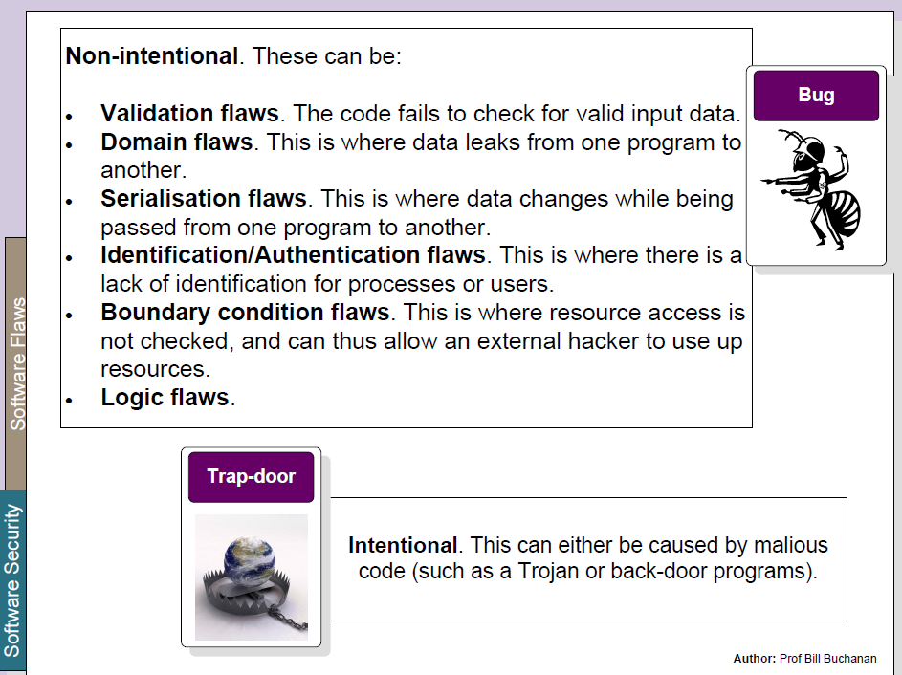
Types of Software Flaws

Slide 16
Bad Software
Software that exposes confidential data to unauthenticated users.
Software which crashes or grinds to a halt when exposed to faulty inputs.
Software which allows an attacker to inject code and execute it.
Software which executes privileged commands for an attacker.

Slide 17
Software Insecurity
Networked software is not designed to withstand a hostile environment.
Development tools do not prevent simple security bugs (i.e., buffer overflows).
QA Testing methods do not address security.
Customers pay for bad software.
Notes:
-Consider that software programming is an art that only has 50 years of age!

Slide 18
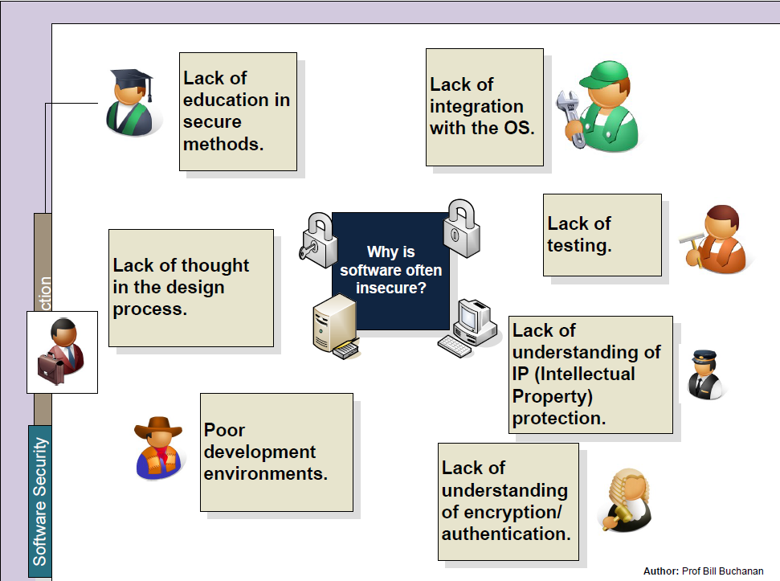
Software Insecurity

Slide 19
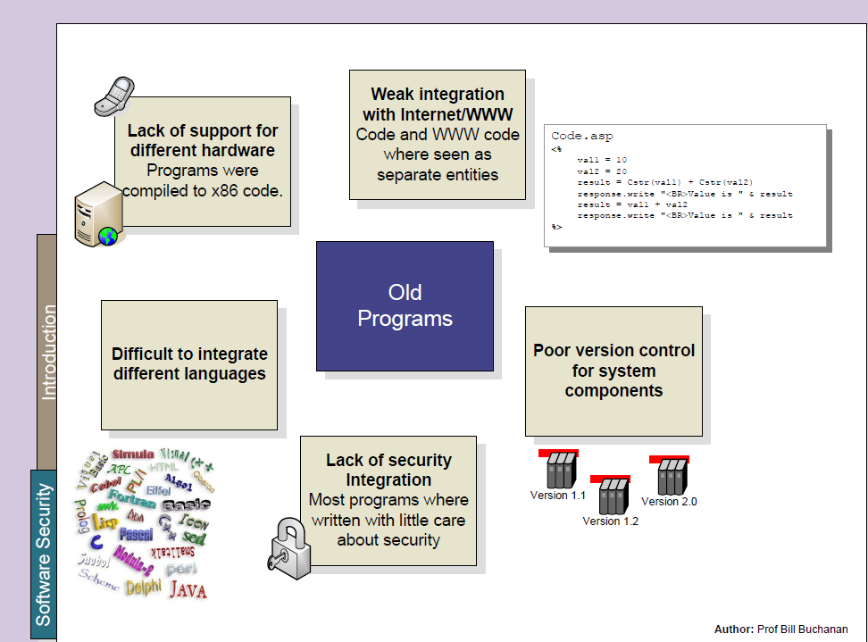
Software Insecurity

Slide 20
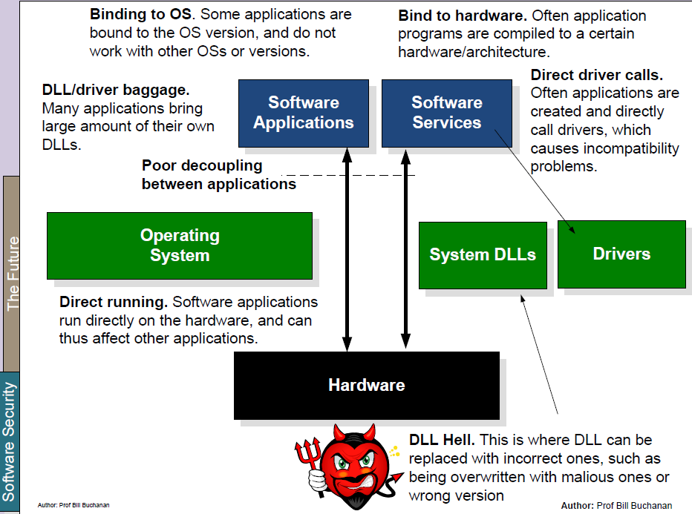
Software Security Assurance

Slide 21
Software Security Questions
What are the methods and technologies, available to us if we want to provide security?
Security in the software development lifecycle.
Engineering & design principles.
Security technologies.
What are the methods and technologies available to the enemy who wants to break security ?
What are the threats and vulnerabilities we’re up against?
What are the resources and tools available to attackers?

Slide 22
Software Security Examples
Cryptography
For threats related to insecure communication and storage.
Access control
For threats related to misbehaving users.
Language-based security
For threats related to misbehaving programs:
Typing
Memory-safety
Sandboxing

Slide 23
Software Error Categories
1. Insecure interaction between components:
Improper neutralisation of:
Special elements used in commands (OS commands, SQL commands, etc.).
Input during web page generation.
Unrestricted upload of files.
URL redirection to untrusted sites.

Slide 24
Software Error Categories
2. Risky resource management:
Buffer copy without size checking.
Improper limitation of a pathname.
Download code without integrity check.
Inclusion of functionality from untrusted resources.
Use of potentially dangerous functions.
Incorrect calculation of buffer size.
Uncontrolled format string.
Integer overflow.

Slide 25
Software Error Categories
3. Porous defences:
Missing authentication for critical function.
Missing authorisation.
Use of hard coded credentials.
Missing encryption of critical data.
Reliance on untrusted inputs in security decisions.
Execution with unnecessary privileges.
Use of broken or risky crypto algorithms.
Improper restrictions on authentication attempts.

Slide 26
Software Error Categories
4. Handling Input:
Input Size and Buffer Overflow.
Interpretation of Program Input.
Binary vs. text
Injection Flaws:
Command injection (e.g. finger*)
SQL injection (SELECT * FROM … where …)
Code, mail, format string, interpreter injection
Validating Input Syntax:
Regular expressions
ASCII Unicode: encoding of “/” is “2F” and “”C0AF”
Input Fuzzing (randomly generated data).

Slide 27
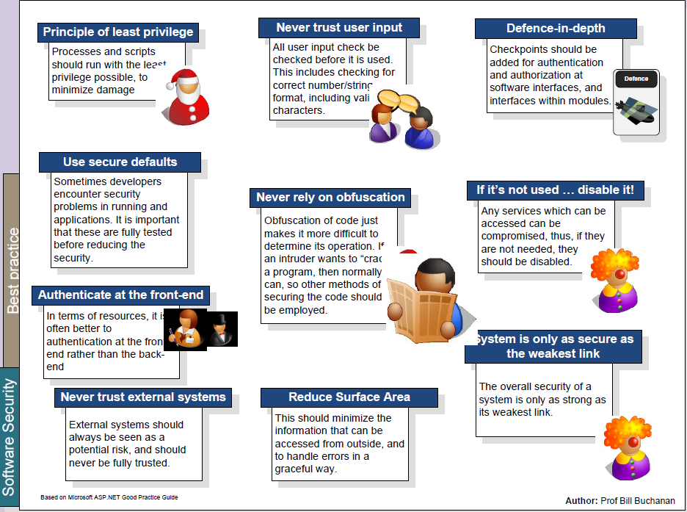
Software Security Best Practices

Slide 28
Demo
Lab 7 Completion

